Slide 1

SEVASUTRA
Team Name: CODE SIRENS
Team Members:
1)Muktai Santosh Kadam
2)Madhura Digambar Hattikat
3)Rohan Parshuram Shinde
4)Rutik Santosh Gamare
5)Riddhesh Vikas Ghate

Slide 2
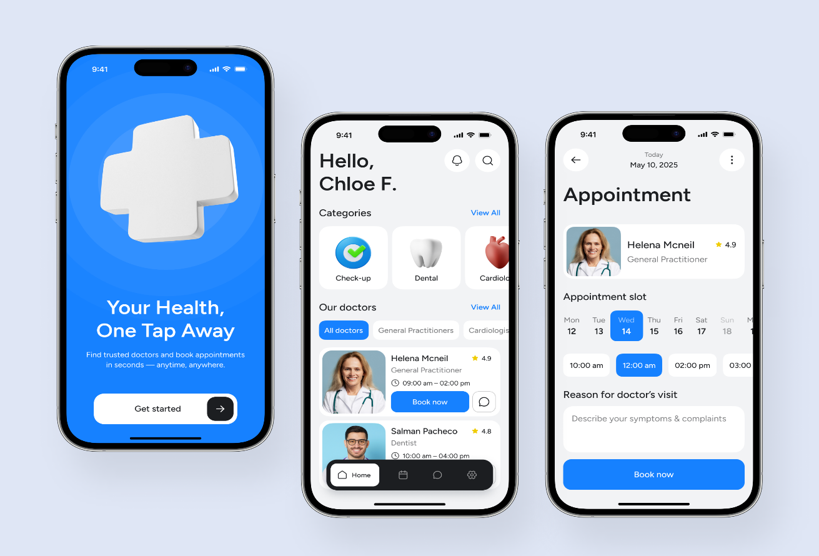
Mobile Healthcare App for Villages
Empowering health workers with offline-first capabilities,bilingual support, and real-time analytics for better community care.

Slide 3
Project Objective
Bridging the gap between remote fieldwork and digital health systems.
Enable Offline Data Capture, Collect forms, photos, audio, and GPS without internet; sync automatically when online.
To improve healthcare accessibility in rural and multilingual regions.
To develop a bilingual data capture system for healthcare workers.

Slide 4
Key Technologies Used
Android Studio
Artificial Intelligence
Visual Studio Code
Flutter
Supabase
Xcode

Slide 5
Methodology
Requirement Analysis
Data collection
Cloud Storage
Testing & Deployment
Monitoring & Improvement

Slide 6
Features of the System
Bilingual interface (local language+ English)
Voice-to-text and automatic translation .
Real-time patient data synchronization.
Offline data collection with later syncing.

Slide 7
Future Scope
Integration with wearable health devices.
Advanced AI-based disease prediction.
Integration with national health databases.
Expansion to multiple regional languages.

Slide 8
Advantages
Faster and accurate data collection .
Eliminates language barriers
Real time access to patient health records.
Reduces paperwork and administrative burden.
Improves decision making for doctors.

Slide 9
THANKYOU !

